Slide 1

Conv2D
256
65

Slide 2
32
MaxPooling
256
65

Slide 3
32
128
Conv2D
32

Slide 4
64
128
MaxPooling
32

Slide 5
64
Conv2D
64
16

Slide 6
128
MaxPooling
64
16

Slide 7
128
Conv2D
32
8

Slide 8
256
MaxPooling
32
8

Slide 9
256
Reshape
16
4

Slide 10
16
Dense
1024

Slide 11
16
Conv1D
128

Slide 12
16
Conv1D
128

Slide 13
16
64

Slide 14
64
16

Slide 15
64
16

Slide 16
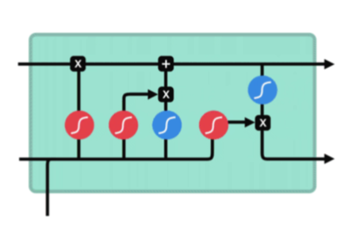
Bidirectional LSTM
64
16

Slide 17
64
16

Slide 18
64
64
64
16

Slide 19
Bidirectional LSTM
64
64
64
16

Slide 20
Bidirectional LSTM
128

Slide 21
64
64
128

Slide 22
64
64
128

Slide 23
LSTM Output
128

Slide 24
values.shape = (none, 16, 128)
query .shape = (none, 128)
128
128
16

Slide 25
values.shape = (none, 16, 128)
query .shape = (none, 1, 128)
128
128
1
16

Slide 26
+
. . .
+
256
+
256
16
1
shape = (none, 16, 128)
shape = (none, 1, 128)

Slide 27
tanh
256
16
shape = (none, 16, 256)

Slide 28
LSTM Output
128
score
1
16
16
values.shape = (none, 16, 128)
weights.shape = (none, 16, 1)

Slide 29
weights
1
LSTM Output
16
weights.shape = (none, 16, 1)
softmax
128
score
1
16
16
values.shape = (none, 16, 128)
weights.shape = (none, 16, 1)

Slide 30
LSTM Output
128
weights
1
16
16
weights.shape = (none, 16, 1)
values.shape = (none, 16, 128)
softmax
score
1
16
weights.shape = (none, 16, 1)

Slide 31
LSTM Output
weights
128
128
Dot Product
16
16
values.shape = (none, 16, 128)
weights.shape = (none, 16, 128)

Slide 32
Context Vector
128

Slide 33
Context Vector Repeated
128
16

Slide 34

LSTM Output
128
Context Vector Repeated
128
16
16
Here, we concatenate the second LSTM output with Context

Slide 35
LSTM Output
128
128
Context Vector Repeated
16

Slide 37
Combined
256
16

Slide 38
Bidirectional LSTM
Combined
256
16

Slide 39
64
64
Combined
256
16

Slide 40
64
64
Combined
256
16

Slide 41
128
16

Slide 42
Dense
128
16

Slide 43
MaxPooling
29
16

Slide 44
Dense
29
8

Slide 45
29
Softmax (
)
8

Slide 46
29
8

